Slide 1
A First Book of ANSI C Fourth Edition
Chapter 4
Selection

Slide 2
Objectives
Relational Expressions
The if and if-else Statements
The if-else Chain
The switch Statement
Case Study: Data Validation
Common Programming and Compiler Errors

Slide 3
Introduction
Flow of control refers to the order in which a program’s statements are executed
Any algorithm can be built using combinations of four standardized flow of control structures:
Normal flow of control for all programs is sequential
Selection is used to select which statements are performed next based on a condition
Repetition is used to repeat a set of statements
Invocation is used to invoke a sequence of instructions using a single statement, as in calling a function

Slide 4
Relational Expressions
Simplest decision structure:
if (condition)
statement executed if condition is true
The condition is evaluated to determine its numerical value, which is interpreted as either true (non-zero) or false (0)
If condition is “true” the statement following the if is executed; otherwise, statement is not executed
The condition used in all of C’s if statements can be any valid C expression
Most commonly, a relational expression (can yield only 0 or 1)

Slide 5
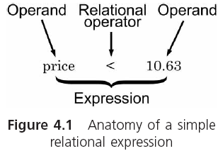
Relational Expressions (continued)

Slide 6
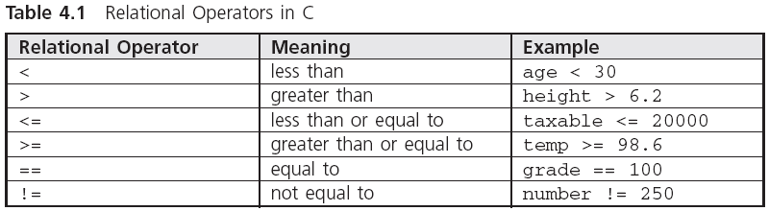
Relational Expressions (continued)

Slide 7
Relational Expressions (continued)
Relational expressions are also known as conditions
A relational expression evaluates to 1 (true) or 0 (false)
The expression 3 < 4 has a value of 1
The expression 2.0 > 3.3 has a value of 0
The value of hours > 0 depends on the value of hours
Character data can also be compared using relational operators

Slide 8
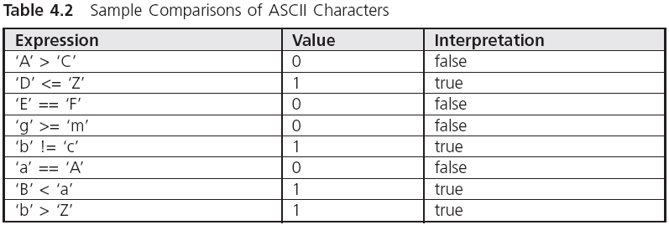
Relational Expressions (continued)

Slide 9
Logical Operators
More complex conditions can be created using the logical operations AND (&&), OR (||), and NOT (!)
When the && is used with two expressions, the condition is true only if both expressions are true by themselves

Slide 10
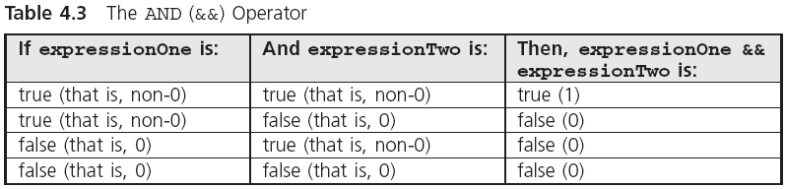
Logical Operators (continued)

Slide 11
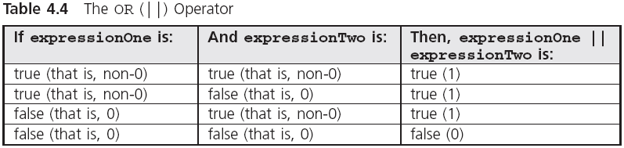
Logical Operators (continued)

Slide 12
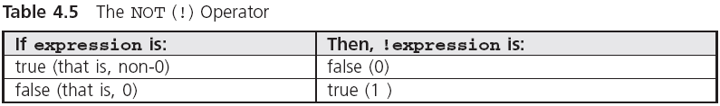
Logical Operators (continued)

Slide 13
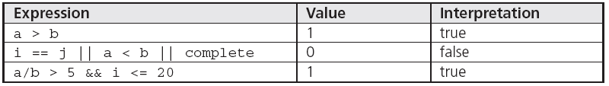
Logical Operators (continued)
int i = 15, j = 30;
double a = 12.0, b = 2.0, complete = 0.0;

Slide 14
Logical Operators (continued)
The evaluation feature for the && and || operators that makes the evaluation of an expression stop as soon as it is determined that an expression is false is known as short-circuit evaluation
Parentheses can be used to alter the assigned operator priority
(6 * 3 == 36 / 2) && (13 < 3 * 3 + 4) || !(6 - 2 < 5) =
(18 == 18) && (13 < 9 + 4) || !(4 < 5) =
1 && (13 < 13) || !1 =
1 && 0 && 0 =
1 && 0 =
0

Slide 15
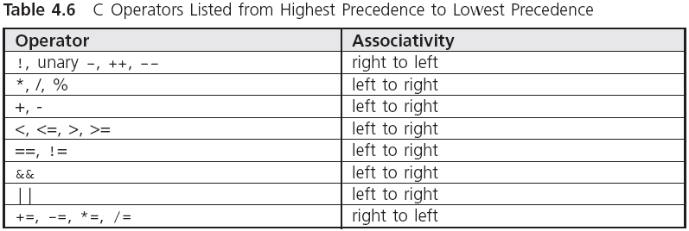
Logical Operators (continued)

Slide 16
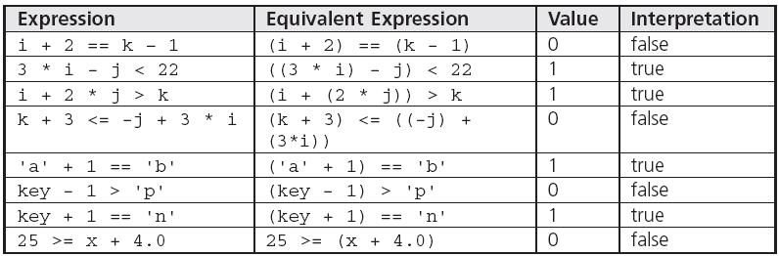
Logical Operators (continued)
char key = 'm';
int i = 5, j = 7, k = 12;
double x = 22.5;

Slide 17
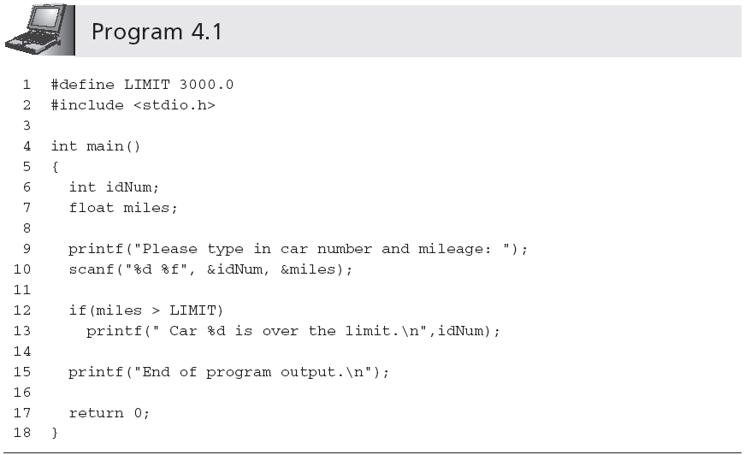
The if and if-else Statements
No semicolon here
One-way if statement

Slide 18
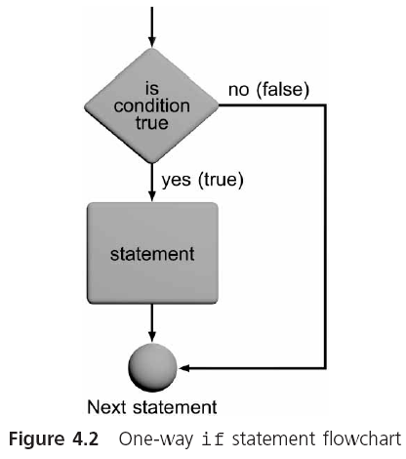
The if and if-else Statements (continued)

Slide 19
Compound Statements
Although only a single statement is permitted in an if statement, this statement can be a single compound statement

Slide 20
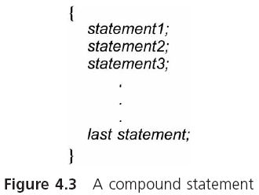
Compound Statements (continued)

Slide 21
Compound Statements (continued)
For example,
if (expression)
{
statement1; /*as many statements as necessary*/
statement2; /*can be placed within the braces*/
• /*each statement must end with ; */
•
•
statementn;
}
For very short statements, you can code a complete if statement placed on a single line
if (grade > 69) ++passTotal;

Slide 22
The if-else Statement
The most commonly used if-else statement is
if (expression)
statement1;
else
statement2;
If the value of expression is 0 statement2, the statement after the reserved word else, is executed

Slide 23
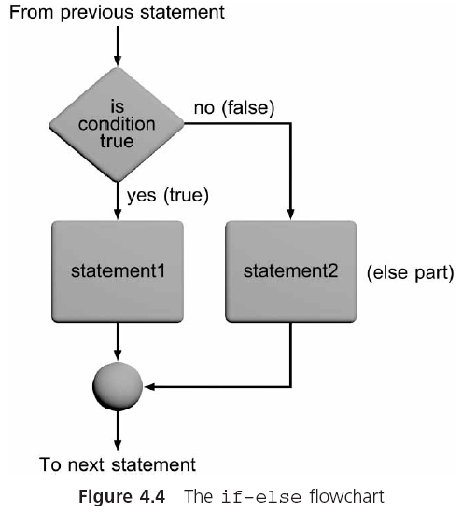
The if-else Statement (continued)

Slide 24
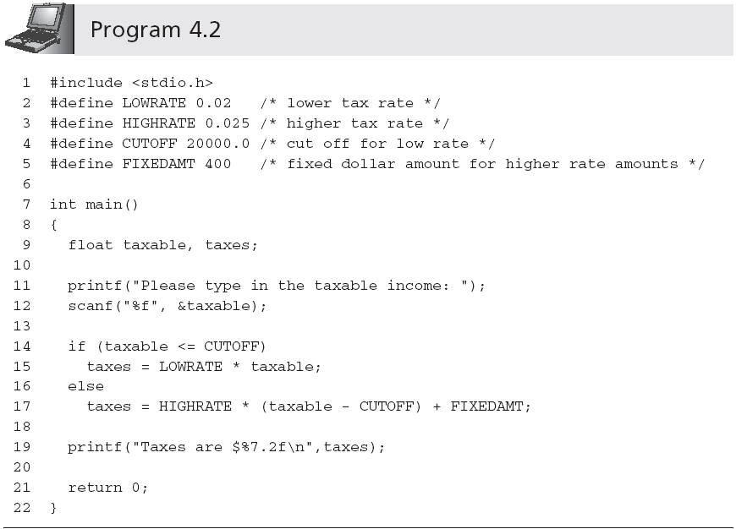
The if-else Statement (continued)

Slide 25
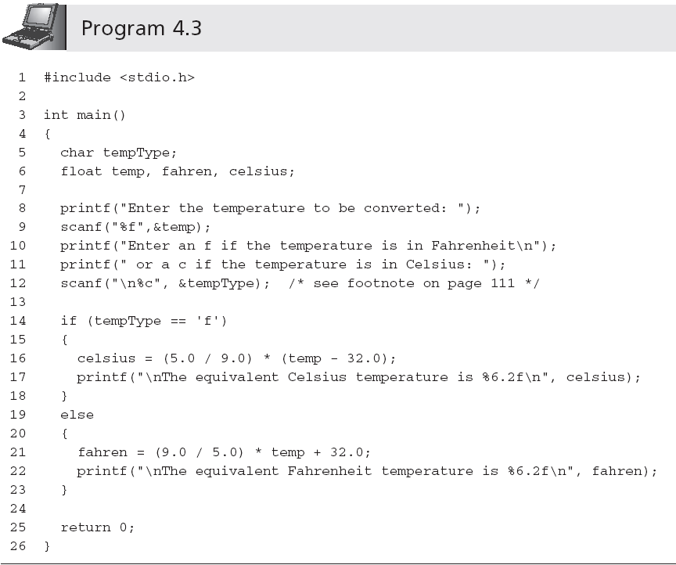
The if-else Statement (continued)

Slide 26
The if-else Chain
Nested if statement:
if (expression1)
statement1;
else
if (expression2)
statement2;
else
statement3;
Whether the indentation exists or not, the compiler will, by default, associate an else with the closest previous unpaired if, unless braces are used to alter this default pairing

Slide 27
The if-else Chain (continued)
if-else chain:
if (expression1)
statement1;
else if (expression2)
statement2;
else
statement3;

Slide 28
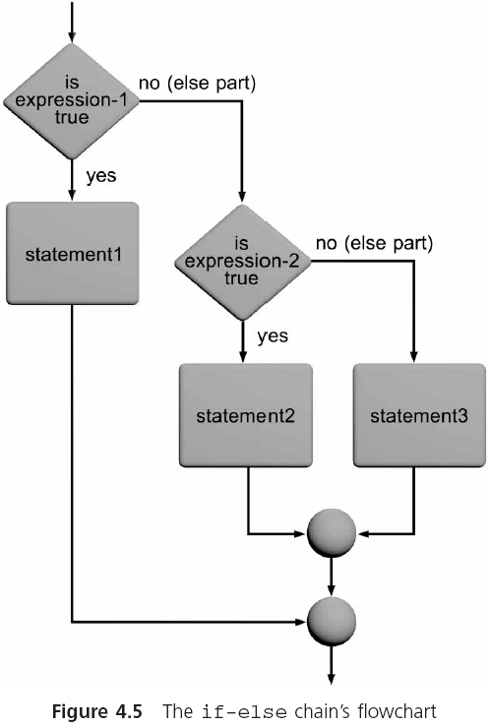
The if-else Chain (continued)

Slide 29
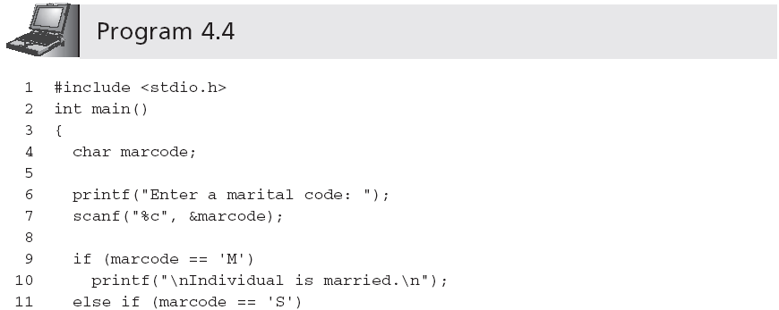
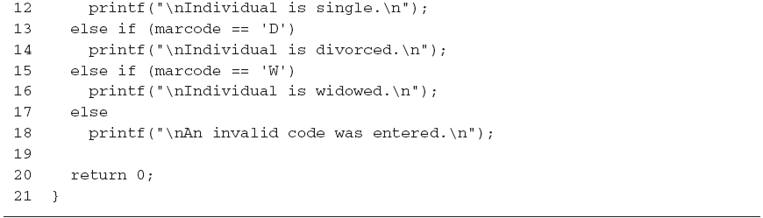
The if-else Chain (continued)

Slide 30
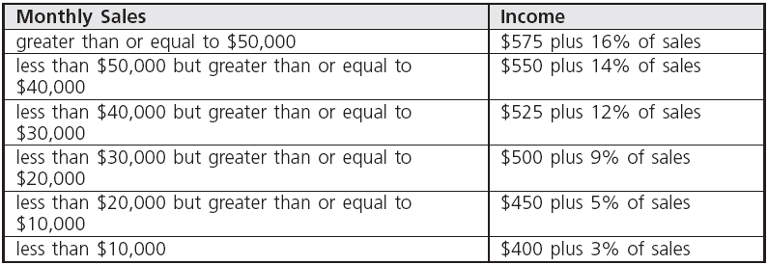
The if-else Chain (continued)

Slide 31
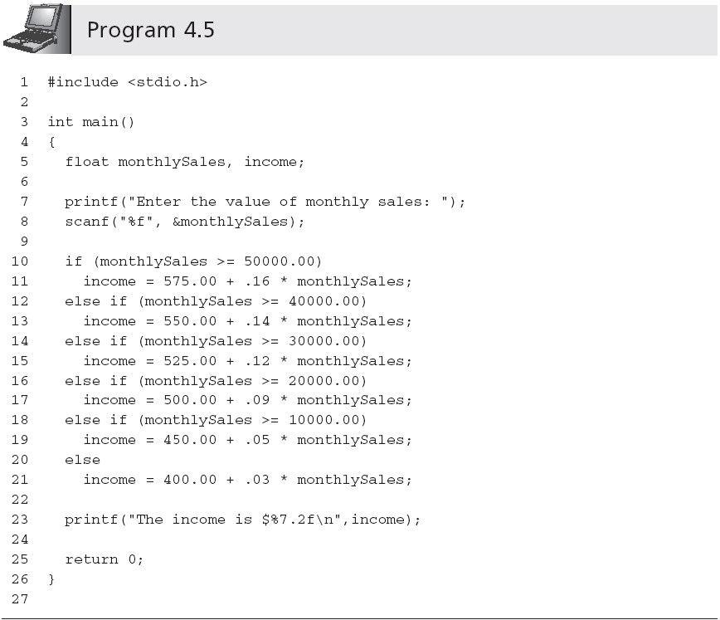
The if-else Chain (continued)

Slide 32
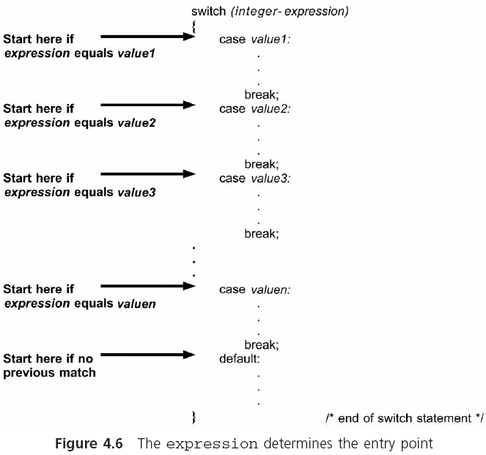
The switch Statement
Terminated with a colon
If the break statement was omitted, the following case would be executed
default is optional

Slide 33
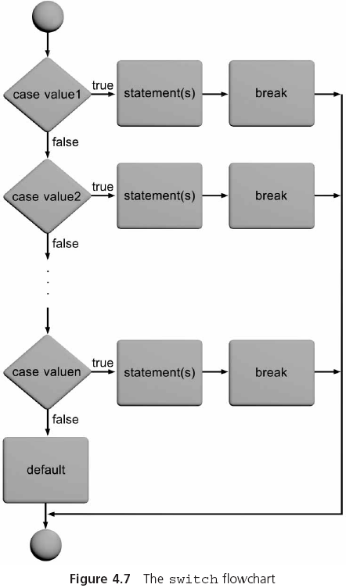
The switch Statement (continued)

Slide 34
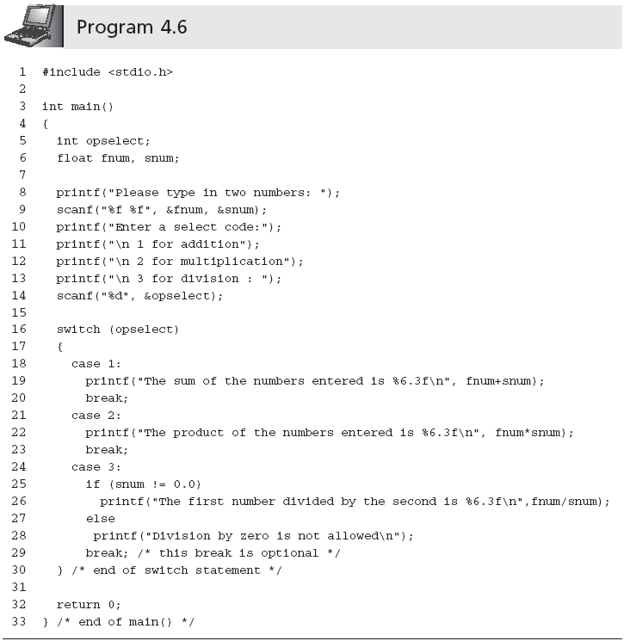
The switch Statement (continued)

Slide 35
Case Study: Data Validation
Defensive programming is a technique where the program includes code to check for improper data before an attempt is made to process it further
Checking user input data for erroneous or unreasonable data is called input data validation
Requirements:
Write a program to calculate the square root and the reciprocal of a user-entered number. Validate that the number is not negative before attempting to take its square root, and that the number is not 0 before calculating the number’s reciprocal value.

Slide 36
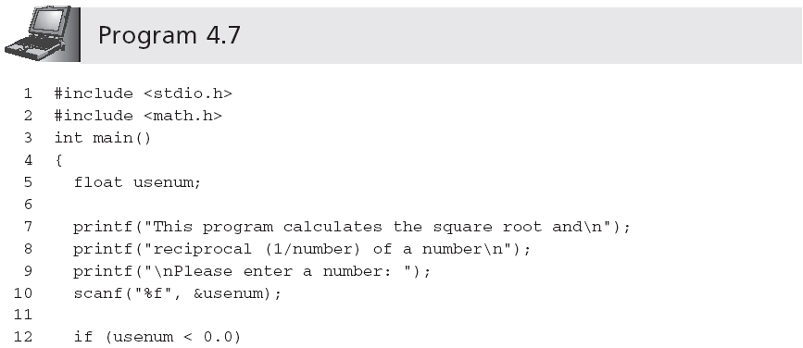
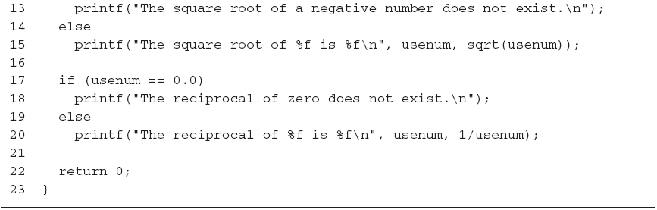
Case Study: Data Validation (continued)

Slide 37
Common Programming Errors
Using the assignment operator, =, in place of the relational operator, ==
Letting the if-else statement appear to select an incorrect choice
Nesting if statements without including braces to clearly indicate the desired structure
Using a single & or | in place of the logical && and logical || operators, respectively

Slide 38
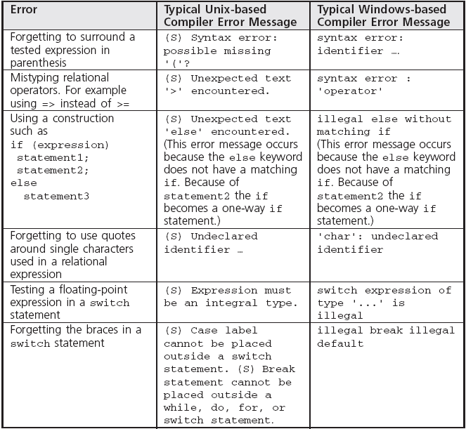
Common Compiler Errors

Slide 39
Summary
Relational expressions, which are also called simple conditions, are used to compare operands
Conditions can be constructed from relational expressions using C’s logical operators, &&, ||, and !
A one-way if statement has the general form
if (expression)
statement;
A compound statement consists of any number of individual statements enclosed within braces
An if-else selects between two alternative statements based on the value of an expression

Slide 40
Summary (continued)
An if-else statement can contain other if-else statements
The if-else chain is a multiway selection statement
The switch statement is a multiway selection statement; program execution is transferred to the first matching case and continues through the end of the switch statement unless an optional break statement is encountered

